Slide 1


Cell Phone Policy Survey Results
Notes:
Good morning everyone!
Two thinks sparked my deeper interest on the issue of cellphone in school. One was when I read a study that observed that the mere presence of a cellphone on a table causes a distraction regardless as to if it is powerd on. And another statistic, that was stunning to me, is that students receive, on average, over two hundred and fifty phone notifications daily.
During the last two years Karen and Nick supported me to further examine the the impact phones were having on our community and the impact of our new cell phone policy.
I created two surveys over the last two years. Thank you to everyone who responded.
I’m here to share the results of those surveys with you.

Slide 2

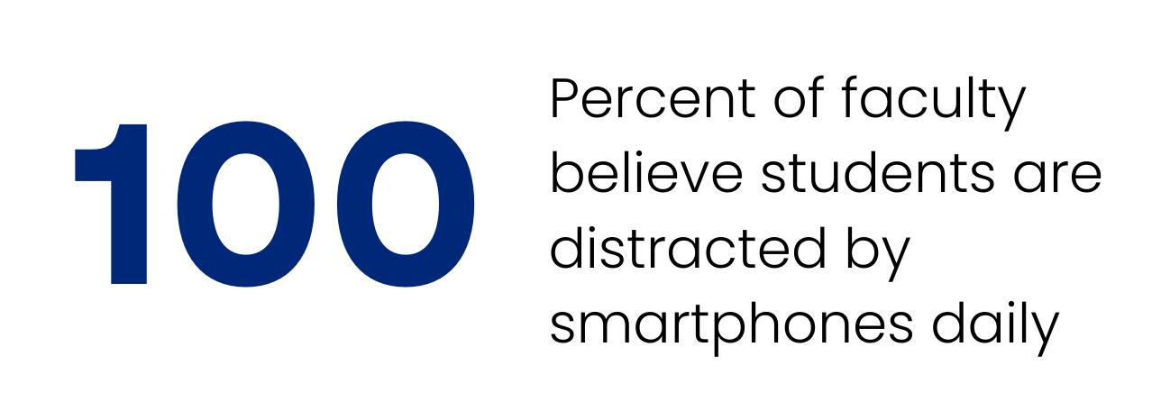
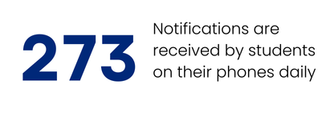
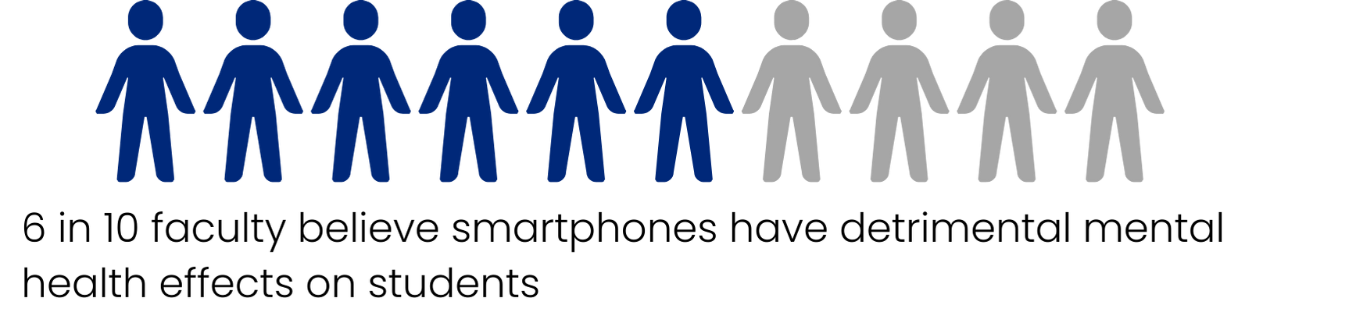
Nov. 2023 Survey
Notes:
In the November 2023 survey, we had 22 faculty respondents.
The 100% percent statistic here demonstrates that the perceived problem of phones around the school was reaching a critical mass.
And 6 in 10 faculty believed smartphones had a detrimental effect on student’s mental health. This is especially concerning because of the importance we put on students mental health. There is so much work great work that goes into that by everyone here, especially the counseling office.
So, this 6 in 10 statistic highlights that phones could potentially be undermining our value of supporting students mental health.
When these statistics are taken together I think this lines up with the ‘perceived crisis’ all schools were at at that point

Slide 3
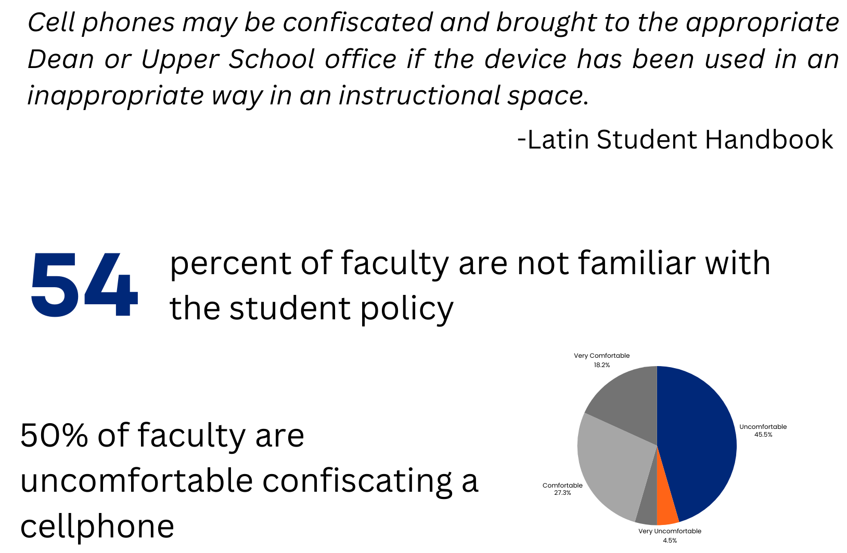
Nov. 2023 Survey
Notes:
This is some information about how our on-the-books policy was being enforced during this period.
The official policy in the handbook was… and read that aaloud.
But I think what was way more telling is that 50% of faculty were uncomfortable confiscating a cell phone. So, if 50% of faculty were uncomfortable enforcing the policy, what does that say about the policy itself? It definitely validated that something needed to change.

Slide 4
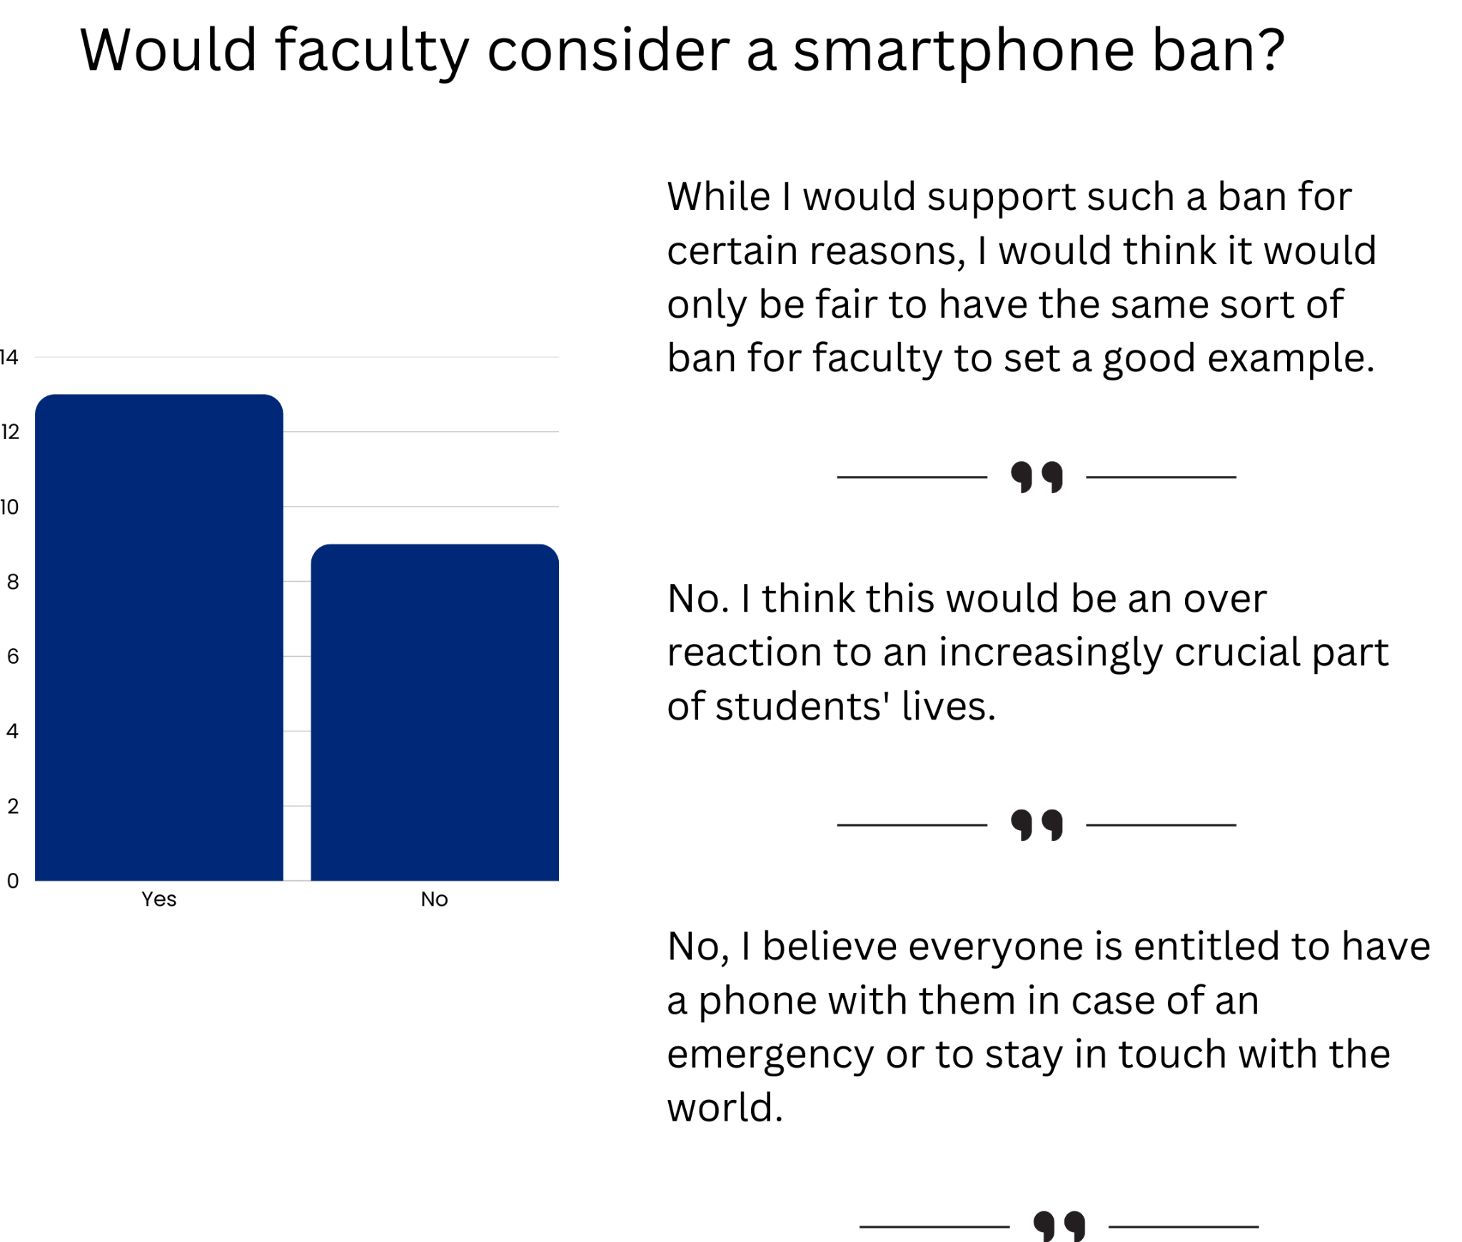
Nov. 2023 Survey
Notes:
Considering there was desire to outright ban cellphones by members of our community, it was important to gauge the actual support for this.
I was surprised by this survey result myself. It seemed with 40% opposed to a ban that an outright ban was untenable.

Slide 5

Survey 2 - Nov. 2024 - 33 Respondents
Notes:
The second annual survey was conducted during the first week of November. After the new phone policy was introduced
There were thirty three respondents
While this number seems obvious, I was actually slightly surprised because of the stance against a phone ban from the last annual survey. However, admin was providing us with new policy that was now clear, universal, and enforceable.

Slide 6
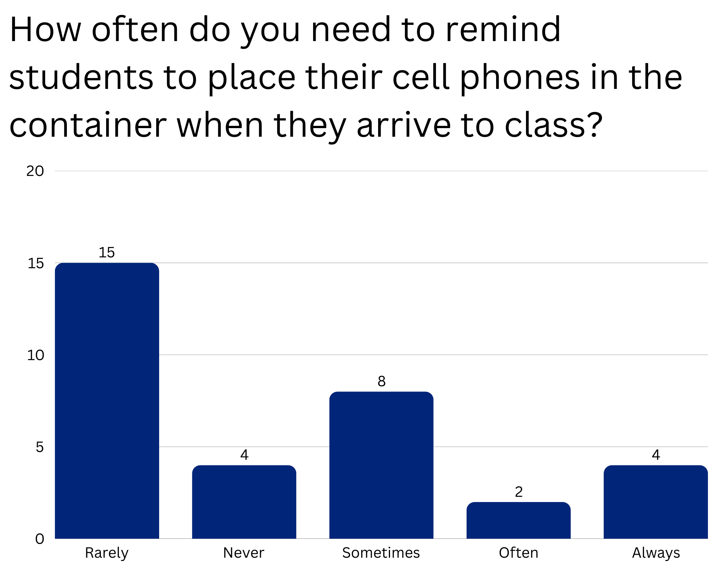
Nov. 2024 Survey
Notes:
One question on the survey asked, <read slide>
The majority of faculty said rarely or never. This was great! It validates a win for the new cell phone policy.
At the same time, 42% fall into the sometimes, often, or always needing to remind students to put their away. This is a sizeable number! It highlights a possible area for improvement.
If you are in the sometimes, often, or always camp feel free to send me an email and I can put you in touch with teachers in the Rarely or Never camp for a deeper conversation on this.

Slide 7
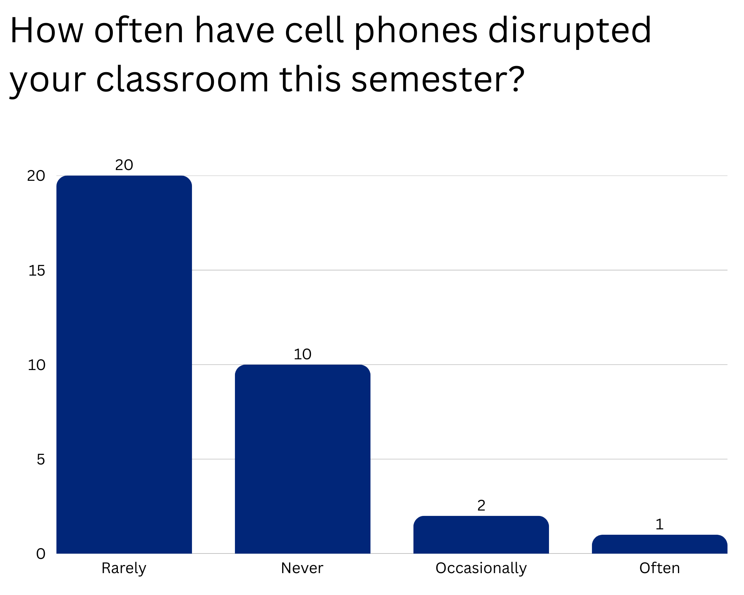
Nov. 2024 Survey
Notes:
The next question asked, <read question>
90% said that cellphones have never or rarely disrupted classrooms so far that semester.
This is great! It appears to show that when the phones finally go away that the policy is again yielding positive results.

Slide 8
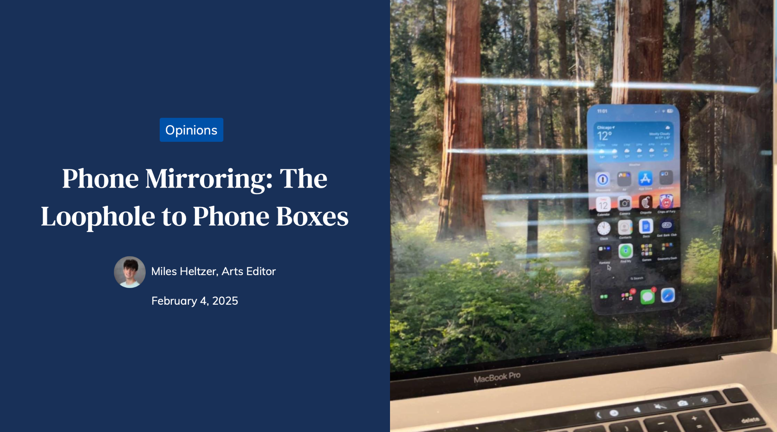
Title
Text
Notes:
With all the seeming success of the new policy, it is still important to gather students perspectives.
This was an excellent article in The Forum.
Unfortunately, it is clear that some students can still get around the policy.
At a deeper level, it highlights that the rate technology innovation will always outpace efforts to limit technology. Especially in this context.
I’m reminded of a famous economist who stated, “There are no solutions, only trade-offs”.
Barring an outright phone ban, To me, the loophole highlights that the issue of phones in school can’t ever be “solved”. And we should only be looking for the most optimal trade-offs.

Slide 9
Conclusion
Notes:
Read the bullet points
Big CONCLUSION: Distracting phones will present a continuous challenge in schools. A grand ‘solution’ is never possible.
The best teachers today, and in the future, need to understand that their job is to create a classroom so invigorating that a student will realize that being present is more compelling than anything happening in the digital world.

